Slide 1
Module 1 - Cloud CI Network Security
This module was developed under the National Science Foundation awards # 2416990, 2416992 and 2607393 at Tennessee Tech University, North Carolina A&T State University and University at Albany.

Slide 2
Slidedeck Outline…
Introduction to Cloud Computing
Intrusion Detection Systems (IDS)
Cloud Network Components
Machine Learning-Based IDS & Feature Engineering
Building, Deploying & Responding with an ML-Based IDS

Slide 3
Section 1: Introduction to Cloud Computing

Slide 4
What Is Cloud Computing?
On-demand delivery of computing resources over the internet
Includes servers, storage, databases, networking, and software
Users pay only for what they consume (utility-style pricing)
Resources are provisioned and released elastically, in minutes
Managed by a cloud provider (AWS, Azure, Google Cloud)
Example:
A university spins up extra servers during exam registration week, then scales back down

Slide 5
The Evolution: On-Premise → Virtualization → Cloud
On-Premise: organizations own and operate all hardware in their own data center
Virtualization: one physical server hosts multiple virtual machines, improving utilization
Cloud Computing: virtualized resources delivered as a service, over the internet, on demand
Each stage reduces the amount of infrastructure an organization must manage directly
Cloud is the natural extension of virtualization, offered at massive, shared scale

Slide 6
Cloud vs. On-Premise Infrastructure
On-Premise
Organization owns and maintains all hardware
High upfront capital cost (servers, cooling, space)
Scaling requires buying and installing new equipment
Full control over physical security and data location
Cloud
Provider owns and maintains the hardware
Pay-as-you-go operating cost, little upfront investment
Scaling is a few clicks away — elastic, on demand
Shared responsibility model for security

Slide 7
Public, Private & Hybrid Cloud
Public Cloud: shared infrastructure operated by a third-party provider (AWS, Azure, GCP)
Private Cloud: dedicated infrastructure used by a single organization, on-prem or hosted
Hybrid Cloud: a mix of public and private — workloads move between the two
Multi-Cloud: using more than one public cloud provider simultaneously
Choice depends on cost, compliance, performance, and control needs

Slide 8
IaaS, PaaS, SaaS — Service Models
IaaS (Infrastructure as a Service): raw compute, storage, and networking (e.g., AWS EC2)
PaaS (Platform as a Service): a ready-made environment for building apps (e.g., Elastic Beanstalk)
SaaS (Software as a Service): fully managed applications delivered over the web (e.g., Gmail, Zoom)
Each layer hands over more management responsibility to the provider
Choosing a model is a trade-off between control and choice

Slide 9
Why Cloud Wins: Scalability, Cost & Elasticity
Elastic Scaling: resources grow or shrink automatically with demand
Pay-as-You-Go: no idle hardware sitting unused
Global Reach: deploy applications close to users worldwide in minutes
High Availability: built-in redundancy across data centers and regions
Reduced Maintenance: provider manages patching, hardware failures, and capacity

Slide 10
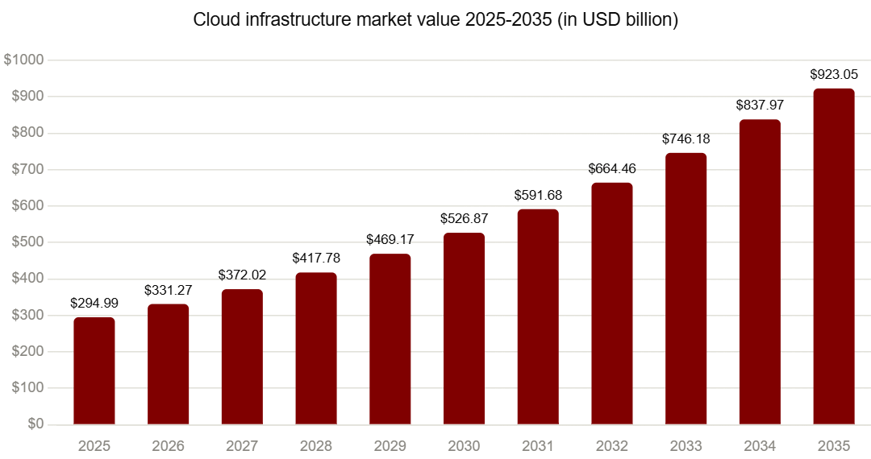
Cloud Market Growth & Adoption Statistics
Worldwide spending on public cloud services continues double-digit growth year over year
The large majority of enterprises now use at least one public cloud service
Ref: https://www.precedenceresearch.com/cloud-services-market

Slide 11
The Cloud-Transformed Enterprise
Education: universities host learning platforms, research computing, and student data in the cloud
Healthcare: cloud enables telemedicine, medical imaging storage, and analytics at scale
Finance: real-time fraud detection and elastic transaction processing
Retail: seasonal scaling for online sales without over-provisioning hardware
Across industries, cloud has shifted IT from a fixed cost to a flexible, on-demand utility

Slide 12
Section 2: Intrusion Detection Systems (IDS)

Slide 13
What Is an Intrusion Detection System?
A system that monitors network or host activity for signs of malicious behavior
Analyzes traffic, logs, or system calls against known patterns or baselines
Raises an alert when suspicious activity is detected
Does not block traffic on its own — that is the role of an IPS
Example:
An IDS flags a sudden spike in failed login attempts as a possible brute-force attack

Slide 14
IDS vs. IPS vs. Firewall
Firewall: filters traffic based on rules (ports, IPs, protocols) — a gatekeeper
IDS: monitors and alerts on suspicious activity — a watchtower
IPS: monitors and automatically blocks malicious traffic — a watchtower with a gate
IDS is passive (detect and alert); IPS is active (detect and respond)
Modern security stacks typically combine all three layers

Slide 15
Host-Based IDS (HIDS)
Installed directly on an individual host (server, workstation, or VM)
Monitors system calls, file integrity, logs, and running processes on that host
Can detect insider threats and local privilege hack
Needs an agent installed on every monitored machine
Blind to network-wide traffic patterns outside its own host

Slide 16
Network-Based IDS (NIDS) & Cloud-Based IDS
NIDS: monitors traffic on a network segment via taps or mirrored ports
Sees traffic between many hosts at once — good for spotting scans and lateral movement
Cloud-Based IDS: monitors traffic within a cloud provider's virtual network (VPC), e.g. AWS GuardDuty
Uses traffic mirroring, since physical taps are not possible in the cloud
Scales elastically alongside the workloads it protects

Slide 17
Machine Learning-Based IDS
Learns normal traffic patterns from data rather than relying on fixed signatures
Can detect previously unseen (zero-day) attacks through anomaly detection
Built from network flow features extracted from captured traffic
Requires labeled or well-understood training data effectively
Increasingly deployed alongside signature-based systems, not as a full replacement

Slide 18
Signature-Based vs. Anomaly-Based Detection
Signature-Based: matches traffic against a database of known attack patterns
Fast and accurate for known threats, but blind to new or modified attacks
Anomaly-Based: builds a model of “normal” behavior and flags deviations
Can catch novel attacks, but is more prone to false positives
Many production IDS combine both approaches for balanced coverage

Slide 19
Comparing IDS Approaches
Approach | Deployment Point | Detects | Key Limitation
HIDS | Individual host | Local file/process/log anomalies | Blind to network-wide activity
NIDS | Network segment | Cross-host traffic patterns, scans | Needs physical/virtual tap access
Cloud-Based IDS | Cloud VPC / virtual network | Traffic across cloud workloads | Depends on provider mirroring features
ML-Based IDS | Anywhere flow data is captured | Known and unknown (zero-day) attacks | Needs quality training data and tuning

Slide 20
Choosing the Right IDS Approach
Consider what you need to protect: a single host, a network segment, or a cloud VPC
Combine layers: HIDS for critical servers, NIDS/Cloud-IDS for network visibility
Add ML-based detection for the attacks signatures haven't seen yet
Balance detection accuracy against false-positive / alert-fatigue costs
Match the IDS to the environment being defended — the university example, next, ties it together

Slide 21
Section 3: Cloud Network Components & a Real-World Example

Slide 22
Core Components of Cloud Infrastructure (AWS)
Amazon VPC: an isolated virtual network within AWS, the example platform used in this section
Subnets: segments of a VPC, split into public and private tiers across Availability Zones
Gateways: Internet Gateway for public access, NAT Gateway for outbound-only access
Elastic Load Balancer (ALB): distributes traffic across multiple EC2 application instances
Compute & Storage: Amazon EC2 instances, plus Amazon RDS and Amazon S3 for data

Slide 23
Case Study: A University System Hosted on AWS
Scenario: a university migrates its student portal, LMS, and research systems to AWS
Thousands of students, faculty, and staff access services daily, on- and off-campus
Systems include: enrollment portal, learning management system, email, research computing
Security must protect student records (FERPA-sensitive data) and research data
This AWS-based case study is used throughout the rest of this module

Slide 24
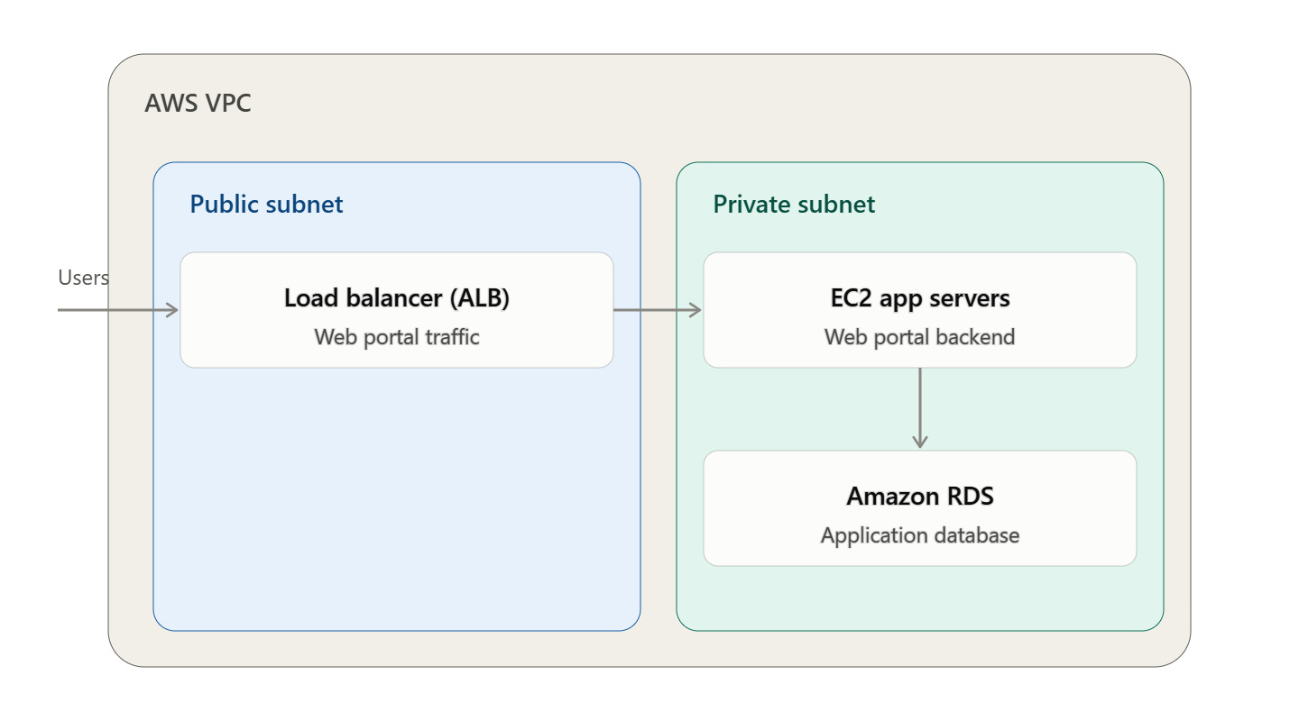
University AWS Network Architecture
Public subnet hosts an Application Load Balancer (ALB) in front of the web portal
Private subnet hosts EC2 application servers and an Amazon RDS database

Slide 25
Data Flow: Student → Application → Database
Student's browser sends an HTTPS request to the university's public-facing ALB
ALB forwards the request to an EC2 application server in the private subnet
Application server queries the Amazon RDS database, also in the private subnet
Response travels back the same path to the student’s browser
Every hop along this path is a potential point of observation for an IDS

Slide 26
Network Security Zones in the University AWS Account
Perimeter Zone: Internet Gateway, security groups / NACL rules, AWS Shield for DDoS protection
DMZ (Public Subnet): Application Load Balancer and web-facing resources, limited exposure
Internal Zone (Private Subnet): EC2 application servers, holds business logic
Data Zone: Amazon RDS and S3 — most restricted, least direct exposure
Traffic between zones should always be inspected, not just traffic from the internet

Slide 27
Where Does IDS Fit in This AWS Architecture?
At the Perimeter: inspects traffic entering and leaving the VPC via the Internet Gateway
Between Zones: watches traffic moving from the public ALB subnet into the private subnet
On Hosts: HIDS agents run on critical EC2 application and database servers
In Traffic Mirrors: Amazon VPC Traffic Mirroring feeds a copy of packets to the ML-based IDS
Goal: no segment of the university's AWS network is invisible to detection

Slide 28
IDS Placement: Taps, Mirroring & Host Agents on AWS
Traditional Network Tap: copies traffic on a physical wire — not available in AWS
Amazon VPC Traffic Mirroring: copies VPC traffic to a monitoring EC2 instance or appliance
Amazon VPC Flow Logs: connection metadata (source, destination, ports, bytes) without full packets
Host Agents: lightweight software on EC2 instances reporting local activity to a central IDS
A layered placement strategy provides both broad visibility and host-level detail

Slide 29
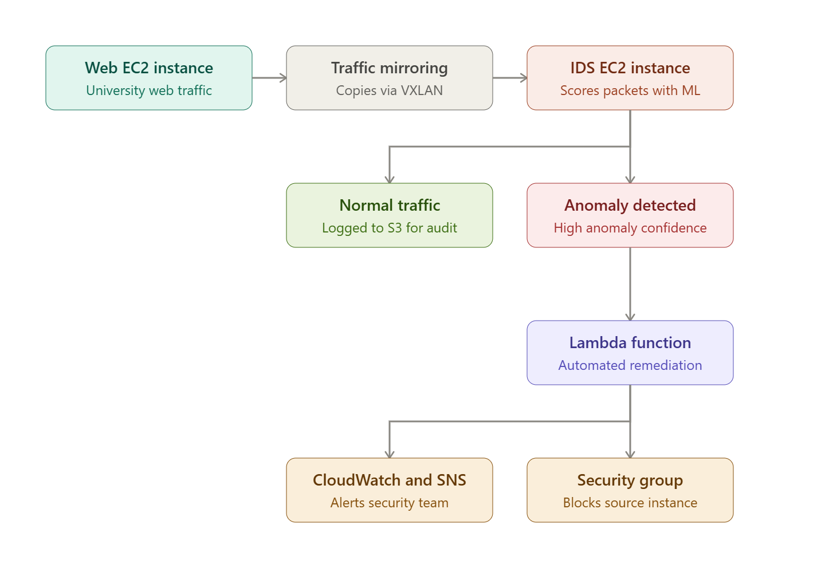
IDS Setup In Cloud Infrastructure

Slide 30
Detecting an Attack: A Walkthrough Example
An attacker begins scanning the university's public IP range for open ports
Perimeter IDS, informed by Amazon GuardDuty findings, flags an unusual burst of connection attempts
The attacker finds a misconfigured service and attempts an SQL injection against the portal
ML-based IDS flags the abnormal query pattern in mirrored traffic before real damage occurs
Security team is alerted, updates the security group to block the source IP, and inspects EC2 logs

Slide 31
Section 4: Machine Learning-Based IDS & Feature Engineering

Slide 32
Why ML for Intrusion Detection?
Attack patterns constantly change — static signatures fall behind
ML models learn from data what “normal” and “malicious” traffic looks like
Can generalize to detect variants of known attacks and some unseen ones
Well-suited to the cloud's scale, where manual rule writing doesn't keep up
Still requires careful feature engineering and evaluation — not a “black-box fix”

Slide 33
From Raw Traffic to Features: The Capture Pipeline
Packet Capture: raw packets are captured at a tap, mirror port, or host interface
Flow Aggregation: packets sharing source/destination/port are grouped into a “flow”
Feature Extraction: statistical and behavioral metrics are computed per flow
Labeling: each flow is tagged as benign or a specific attack type (in training data)
Model Input: the resulting feature vectors are what the ML classifier actually sees

Slide 34
Feature Extraction Tools
CICFlowMeter: generates labeled bidirectional flow features from packet captures (.pcap)
Zeek (formerly Bro): a network analysis framework producing detailed connection logs
Suricata: an open-source IDS/IPS engine that can also export flow-level metadata
NetFlow / IPFIX: standard flow-record formats supported by most network devices
These tools turn raw packet captures into the tabular data ML models require

Slide 35
Introducing the HIKARI-2021 Dataset
A modern intrusion detection dataset built to reflect encrypted, real-world traffic
Captures both benign background traffic and several categories of attacks
Addresses limitations of older datasets (outdated protocols, unrealistic traffic)
Includes both raw packet captures and pre-computed flow-based features
Widely used for benchmarking ML-based network intrusion detection

Slide 36
HIKARI-2021: Traffic Categories
Benign: normal, legitimate user and application traffic
Background: everyday network noise not tied to a specific application session
Probing: reconnaissance activity, such as port and vulnerability scanning
Bruteforce-XML: attacks against web application inputs (inject malicious entity references directly into the XML input)
Brute Force: repeated login attempts to guess credentials
XMRIGCC CryptoMiner: stealing the organization's computing power and spiking electricity bills to mine Monero or other Crypto resource

Slide 37
Key HIKARI-2021 Features — Flow & Volume Metrics
Flow Duration: total time the connection was active
Total Fwd/Bwd Packets: packet counts in each traffic direction
Total Fwd/Bwd Bytes: total bytes transferred in each direction
Packet Length Statistics: mean, max, min, and standard deviation of packet sizes
These describe how much data moved and in which direction — a first fingerprint of the flow

Slide 38
Key HIKARI-2021 Features — Statistical & Timing Metrics
Inter-Arrival Time (IAT): time gaps between consecutive packets, mean and variance
Flow Bytes/Packets per Second: throughput-style rate feature
Flags Count: TCP flag frequency (SYN, ACK, FIN, RST) — reveals scanning or reset patterns
Active/Idle Time: durations a flow was active vs. sitting idle
Timing features often separate automated attack traffic from human-driven traffic

Slide 39
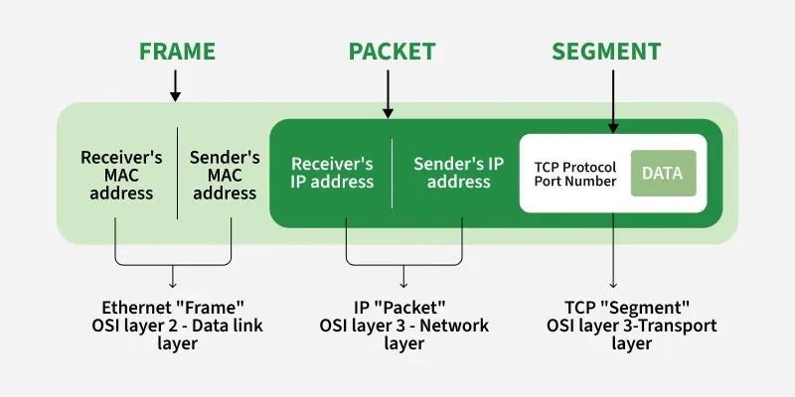
Data encapsulation process across OSI layers
Ref: https://www.geeksforgeeks.org/computer-networks/difference-between-segments-packets-and-frames/

Slide 40
Feature Selection & Dimensionality Reduction
Raw flow data can include 80+ candidate features — many are redundant or irrelevant
Correlation analysis removes features that duplicate information
Feature importance from tree-based models (e.g., Random Forest) ranks the most useful features
Dimensionality reduction (e.g., PCA) can compress features while preserving signal
Fewer, well-chosen features train faster and generalize better in production

Slide 41
Section 5: Building, Deploying & Responding with an ML-Based IDS

Slide 42
Preparing the Dataset for Training
Split data into training, validation, and test sets — never test on training data
Address class imbalance: attacks are typically a small fraction of total traffic
Techniques include oversampling (e.g., SMOTE), undersampling, or class weighting
Normalize or scale numeric features so no single feature dominates the model
Hold out a realistic test set that reflects deployment traffic, not just lab conditions

Slide 43
Choosing a Classifier
Random Forest: robust, interpretable, handles mixed feature types well
Gradient Boosting (e.g., XGBoost): often top performance on tabular flow data
Neural Networks: can model complex patterns, but need more data and tuning
Simpler models are often easier to explain to security analysts and auditors
Start with a strong baseline (e.g., Random Forest) before reaching for complexity

Slide 44
Why Accuracy Alone Is Misleading
Intrusion traffic is rare — a dataset can be over 95% benign
A model that always predicts “benign” can score 95%+ accuracy while catching zero attacks
High accuracy can hide a model that is functionally useless for security
Security teams care about catching attacks, not just being “right” on average
This is why precision, recall, and F1 score matter more than raw accuracy

Slide 45
Precision, Recall & F1 Score Explained
Precision: of the flows flagged as attacks, how many really were attacks?
Recall: of all the real attacks, how many did the model actually catch?
F1 Score: the harmonic mean of precision and recall, balancing both
High precision, low recall: few false alarms, but attacks slip through
High recall, low precision: catches attacks, but floods analysts with false alarms

Slide 46
Why F1 Score Matters for Intrusion Detection
Optimizing for accuracy alone can produce a model that ignores rare attack classes
F1 score forces a balance: catching attacks without drowning analysts in false alarms
Especially important for imbalanced classes, like Brute Force or XSS in HIKARI-2021
Per-class F1 scores reveal which attack types the model struggles to detect
Reporting F1 alongside accuracy gives a far more honest picture of real-world performance

Slide 47
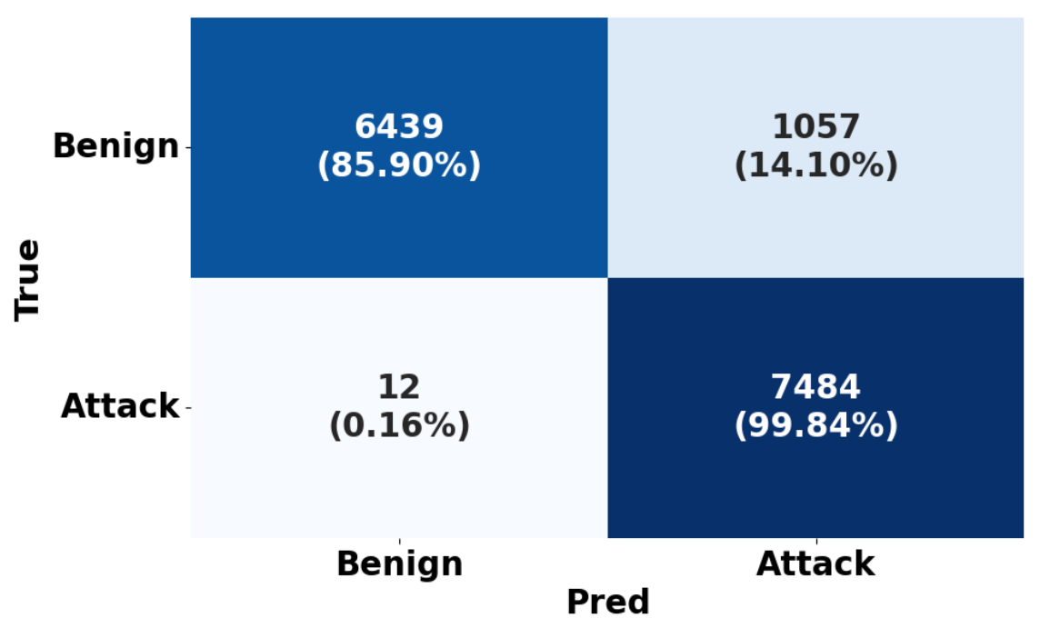
Confusion Matrix Walkthrough
True Positive: attack correctly flagged as an attack
False Positive: benign traffic incorrectly flagged as an attack
False Negative: real attack missed and labeled benign

Slide 48
Deploying the Model on AWS
Package the trained model behind an Amazon SageMaker endpoint or a container on Amazon ECS/EKS
Feed it live flow features from Amazon VPC Traffic Mirroring or VPC Flow Logs in near real time
Auto-scale the inference service with the traffic volume it inspects
Version and monitor the model in SageMaker Model Registry — retrain as traffic patterns evolve
Log every prediction to Amazon CloudWatch for later auditing and performance review

Slide 49
Incident Response After Detection
Alert: the IDS raises a flagged event with a confidence score to the security team
Triage: an analyst reviews the flow features and context around the alert
Contain: block the offending IP, isolate the affected host, or revoke credentials
Investigate: examine logs on the affected systems to assess actual impact
Recover & Learn: patch the exploited weakness and feed the incident back into retraining

Slide 50
Summary
Cloud computing replaced fixed, on-premise infrastructure with elastic, on-demand resources
IDS options range from host-based to network-based to cloud-native to ML-based
Real cloud architectures — like a university's — have clear zones where IDS should be placed
ML-based IDS relies on carefully engineered flow features, such as those in HIKARI-2021
F1 score, not accuracy, is the right way to judge an intrusion detection classifier
A deployed IDS is only useful when paired with a clear incident response process

Slide 51
References
A. Ferriyan, A. H. Thamrin, K. Takedaand J. Murai, ‘HIKARI-2021: Generating Network Intrusion Detection Dataset Based on Real and Encrypted Synthetic Attack Traffic’, Applied Sciences, vol. 11, no. 17. Zenodo, p. 17, Jun. 01, 2021. doi: 10.5281/zenodo.5199540.Intrusion Detection and Prevention Systems (IDPS)
K. -A. Tait et al., "Intrusion Detection using Machine Learning Techniques: An Experimental Comparison," 2021 International Congress of Advanced Technology and Engineering (ICOTEN), Taiz, Yemen, 2021, pp. 1-10, doi: 10.1109/ICOTEN52080.2021.9493543.
Cloud, Hybrid. "The nist definition of cloud computing." National institute of science and technology, special publication 800.2011 (2011): 145.
Applications | Research | Canadian Institute for Cybersecurity | UNB, https://www.unb.ca/cic/research/applications.html.
M. Mia, M. M. A. Pritom, T. Islam and K. Hasan, "Visually Analyze SHAP Plots to Diagnose Misclassifications in ML-based Intrusion Detection," 2024 IEEE International Conference on Data Mining Workshops (ICDMW), Abu Dhabi, United Arab Emirates, 2024, pp. 632-641, doi: 10.1109/ICDMW65004.2024.00088.

